Slide 1

Agent Based Modelling: Market Manipulation
Group Members:
Yu-Hsun Wang / Pin-Chi Chen / Hsiao-Ching Liu
/ Bo Xu / Xuanming Gu

Slide 2
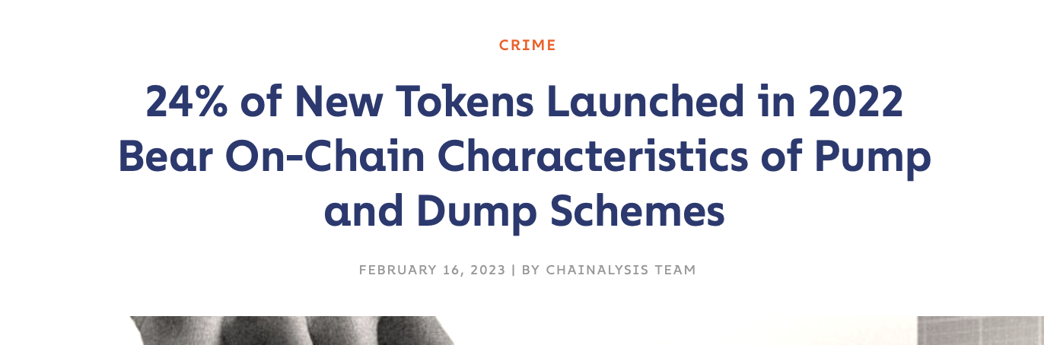
Notes:
講一下市場操縱跟pnd的定義，並且提及幣圈的pnd問題嚴重性，進而帶出為什麼需要建這個模型（說服立法者制定適當法律制裁操縱者）

Slide 3
The complexity of financial markets
Financial markets are complex systems with various agents interacting
Agents have different goals, beliefs, and strategies
Understanding agent behavior is crucial for policymakers, investors, and traders

Slide 4

The role of big investors
Big investors are institutional investors with a large amount of capital
Influence the market and get profit from market trends and fluctuations
There has been increasing interest in studying the impact of big investors on financial markets

Slide 5
Our agent-based model
The model simulates the behaviour of various agents, including random traders, chartists, and the big investor
It assumes a closed environment and a limit order book (LOB) mechanism
The model uses MACD as a key technical indicator

Slide 6
The purpose of the model
Examine the manipulation effect of big investors on the market
Investigates how big investors use their capital and complex strategies to generate upward momentum and profit from the market
Examines the impact of big investors on market volatility and their interaction with other agents, such as chartists and random traders

Slide 7
Model assumptions
Closed environment
Three types of agents:
Random traders
Chartists
The big investor
Fixed order quantity
No regulatory measures or transaction taxes

Slide 8


Market participants
180 random agents
20 chartists
1 big investor

Slide 9
Methodology - Model parameters
Initial wealth of investors
80 shares+ $1000 cash
80 shares+ $1000 cash
adjustable

Slide 10
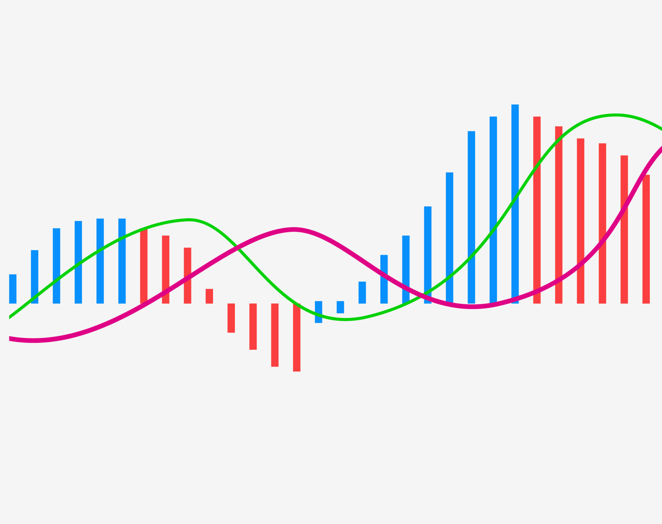
Methodology - Momentum Strategy
Utilized the Moving Average Convergence Divergence (MACD) strategy
MACD Line = 12-day EMA − 26-day EMA
Signal Line = 9-day EMA of the MACD Line
MACD – Signal > 0 : buying signal
MACD – Signal < 0 : selling signal

Slide 11
Methodology - Model parameters
Duration of big investor's strategy is 100 ticks
Orders in the market expire every 15 ticks
Investors submit buy or sell orders when they run out of stocks or funds with a 25% chance

Slide 12
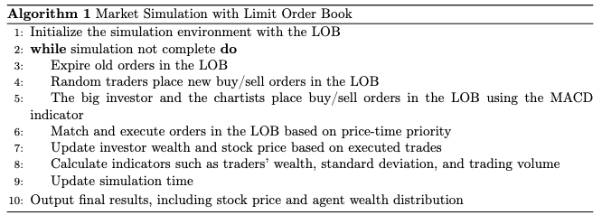
Pseudo Code

Slide 13
3 Scenarios
Scenario 1
Scenario 2
Scenario 3

Slide 14
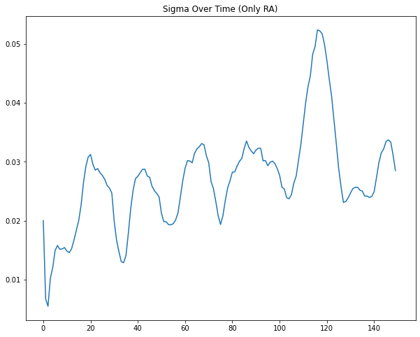
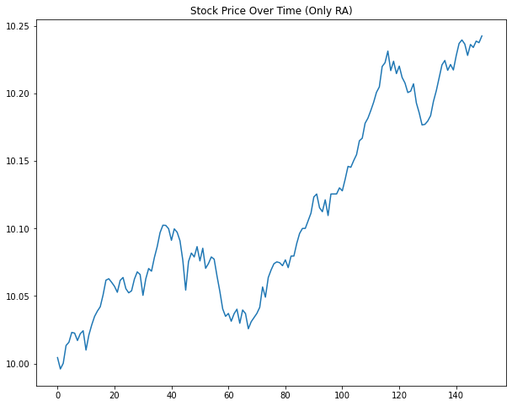
S1

Slide 15
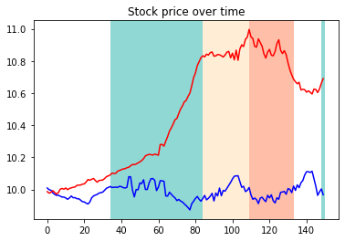
Comparing S2 with S3

Slide 16
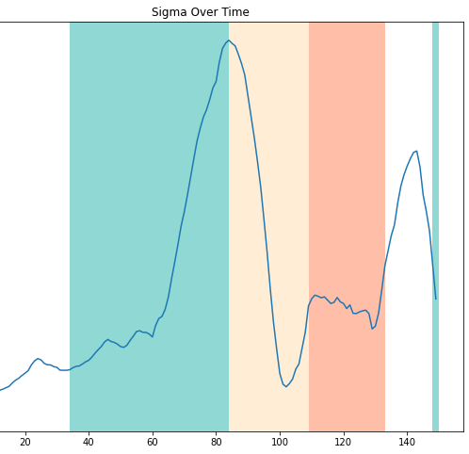
S3 Sigma
Pump : the volatility would upsurge.
The static stage : Plummet to almost 0
Dump : Went up to a certain level

Slide 17
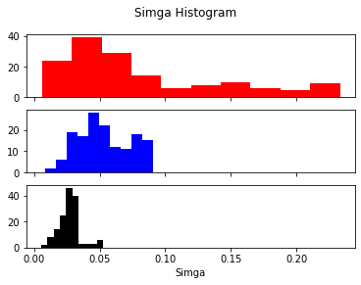
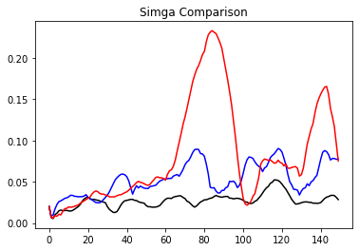
The big investor significantly increased market volatility
This affect the magnitude of stock price movements.
We can easily compare the three scenarios with the histograms on the right side.
S3
S2
S1

Slide 18
Results
The return from 3 different situation in 2000 ticks
The big investor had outperformed the other investors with a respectable return.
 | Random Agents | Chartists | The Big Investor
Return rate | -29.05 % | 109.03 % | 157.06 %

Slide 19
Potential Mitigation Strategies
Enhanced Market Surveillance
Implement advanced data analytics and artificial intelligence techniques to monitor market activities in real-time.
Detect unusual trading patterns and identify potential pump and dump schemes early.
Increased Transparency
Encourage greater transparency in financial markets by mandating timely and accurate disclosure of relevant information.
Promote the use of secure and transparent platforms for conducting market transactions.

Slide 20
Future Work
Define better-designed big-investor strategies
Introduce new investor types
Consider the trading countdown
Insert multiple stocks in our model

